Slide 1

Arduino Uno R3
Complete Guide & Starter Kit Tutorials
The Perfect Board for Beginners

Slide 2

What is Arduino Uno?
The Arduino Uno R3 is the most popular microcontroller board, perfect for learning electronics and programming.
5V
Operating Voltage
USB
Key Specifications
Easy Connection
Arduino Uno R3 microcontroller
13 digital input/output pins
6 analog input pins
16 MHz clock speed
32 KB flash memory
R3
Latest Revision

Slide 3
Arduino IDE
Arduino IDE is the main application used for writing Arduino Code. If it's not already installed on your device go to this link and click Arduino IDE download.
Code
https://github.com/jckorogob/Arduino-Introduction-Workshop-UB

Slide 4
Essential Terminology
Digital Pin
Analog Pin
Reads or writes HIGH (5V) or LOW (0V) signals
Reads variable voltage from 0-5V as values 0 - 1023
PWM
Sketch
Pulse Width Modulation - simulates analog output
The name for an Arduino program or code file
Serial Monitor
Breadboard
Tool to send/receive text data to/from Arduino
Reusable board for prototyping without soldering

Slide 5
More Kit Components
Servo Motor
Rotates to specific angles (0-180°). Controlled via PWM signals.
LCD Display (16x2)
Shows text in 2 rows of 16 characters. Requires multiple digital pins.
Jumper Wires
Connect components on breadboard. Male-to-male for breadboard connections.

Slide 6
LED (Light Emitting Diode)
Emits light when current flows through it. Has polarity - long leg is positive.
Resistor
Limits current flow. Use 330Ω with LEDs to prevent burnout. 220Ω resistors also works but are very bright
Push Button
Creates or breaks electrical connection when pressed. Use pull-up or pull-down resistors.
Potentiometer
Variable resistor with rotating knob. Outputs voltage from 0-5V to analog pins.

Slide 7

Tutorial 1
Blinking LED
Your First Arduino Project

Slide 8
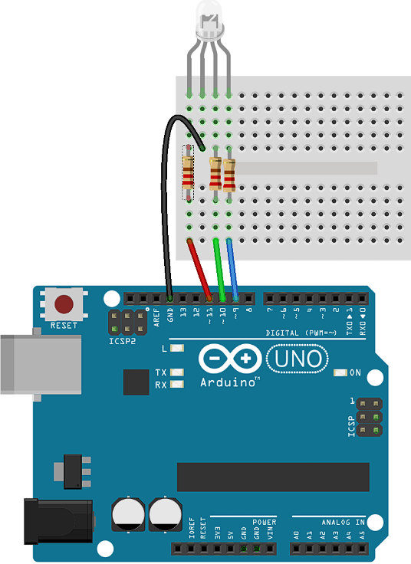
Tutorial 1: Blinking LED
Code
https://github.com/jckorogob/Arduino-Introduction-Workshop-UB
Components Needed
1x LED (RGB)
3x 330Ω resistors
4x male to male jumper wires
Breadboard
Circuit Setup
Connect LED long leg GND
Connect resistor to all LED short legs
Connect resistor to pins

Slide 9
Tutorial 2
Button-Controlled LED
Reading Digital Input

Slide 10
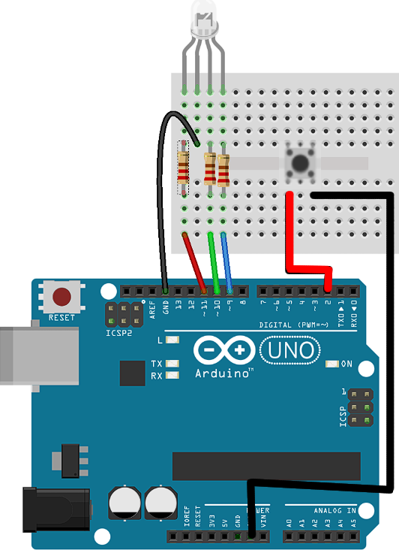
Tutorial 2: Button-Controlled LED
Code
https://github.com/jckorogob/Arduino-Introduction-Workshop-UB
Components Needed
1x LED (RGB), 1x 330Ω resistor
1x push button
1x 10kΩ resistor (pull-down)
5x male to male Jumper wires , breadboard
Circuit Setup
LED circuit on pin 11, 10, 9
Button left leg to 5V
Button right leg to pin 2

Slide 11
Tutorial 3
Controlling a Servo
Using Potentiometer & PWM

Slide 12
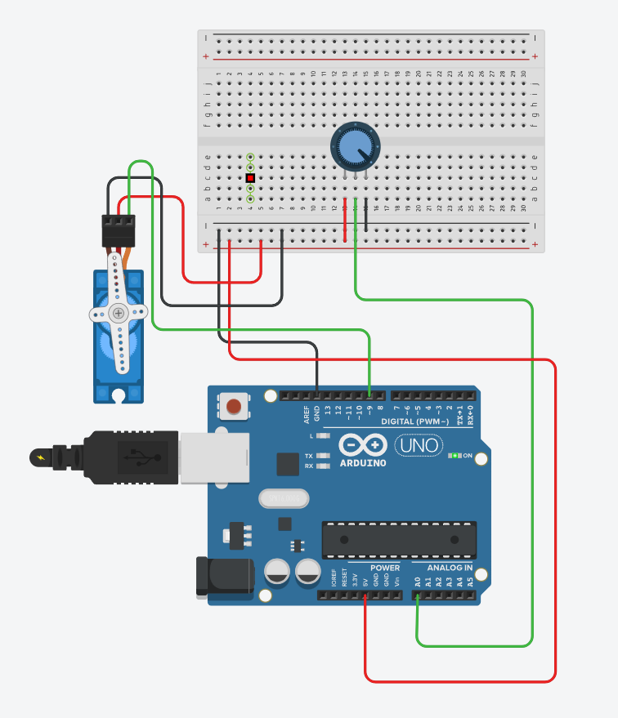
Tutorial 3: Controlling a Servo
Code
https://github.com/jckorogob/Arduino-Introduction-Workshop-UB
Components Needed
1x Servo Motor
1x Potentiometer (10kΩ)
8x male to male Jumper wires, breadboard
Circuit Setup
Servo to PWM pin 9, black to GND, red to 5V
Potentiometer middle pin to A0
Pot outer pins to 5V and GND

Slide 13
Tutorial 4
Snake Game
Try it out!

Slide 14
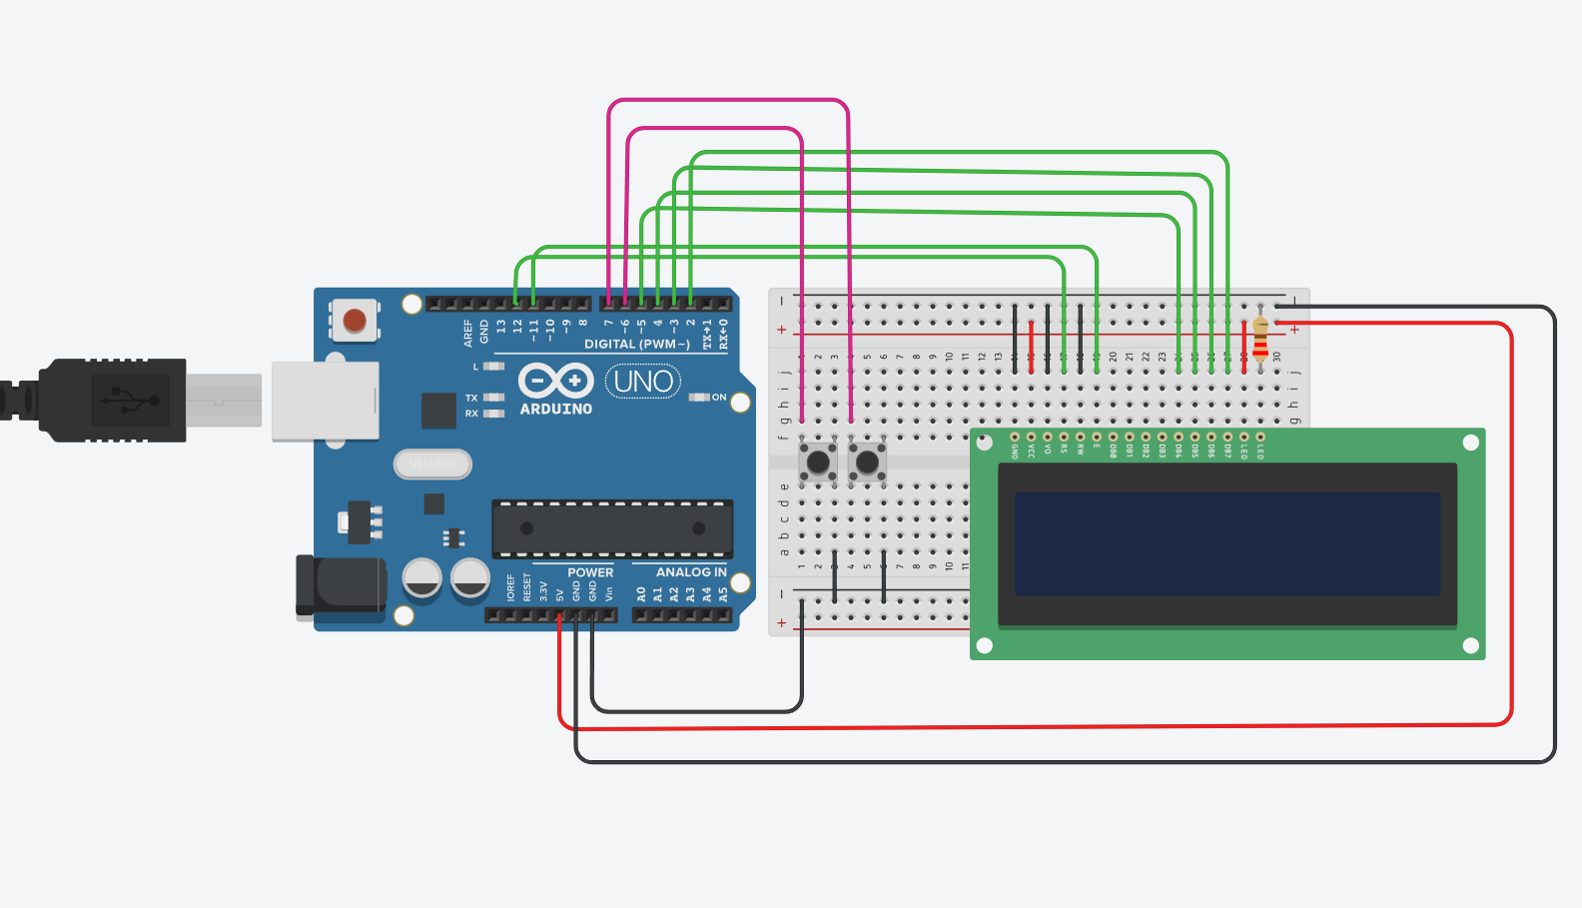
Tutorial 4: Snake Game
Code
https://github.com/jckorogob/Arduino-Introduction-Workshop-UB
Components Needed
2x Buttons
1x 16x2 LCD, 1x 330Ω resistor
16x male to male Jumper wires, breadboard
Circuit Setup
Hook up LCD same way as diagram
Button one leg to pin 2 and other to GND
Connect 5V and GND to breadboard

Slide 15

Ready to Build!
You now have the foundation to create amazing projects with Arduino Uno R3
Next Steps
Combine sensors with actuators
Experiment with servo motors
Explore the Arduino library
Create some awesome projects!

Slide 16

Ready to Build!
You now have the foundation to create amazing projects with Arduino Uno R3
Next Steps
Combine sensors with actuators
Experiment with servo motors
Explore the Arduino library
Create some awesome projects!

